Slide 1
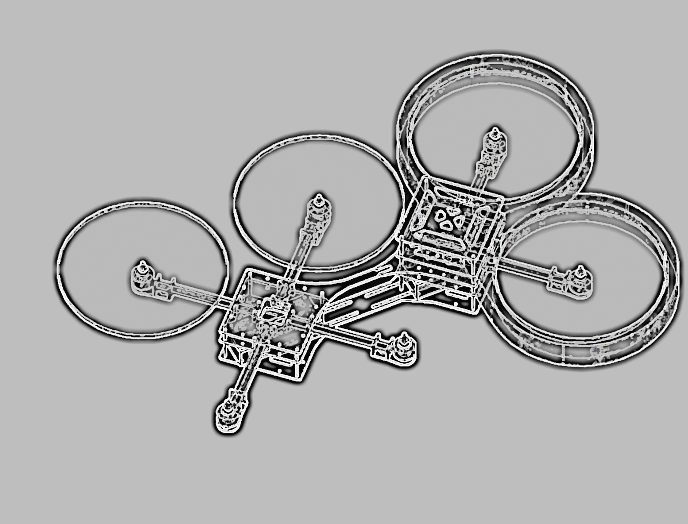

Integrated Project
Fall Semester 15/16
University of Applied Sciences Ulm
X-COPTER

Slide 2

The X-Copter Project: Table of Content
University of
Applied Sciences
Table of Content
Overview
Project Management
System Architecture
Hardware
Linux
Flight Controller
Challenges
Conclusion
Lessons Learned

Slide 3
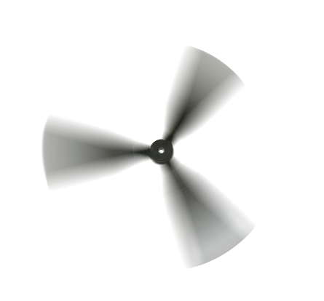

The X-Copter Project: Overview
University of
Applied Sciences
Introduction
The X-Copter will be an autonomous modular multicopter
Fields of application
3D Mapping
Rescue Missions
Surveillance
Parcel delivery
Movie Production

Slide 4

The X-Copter Project: Overview
University of
Applied Sciences
Customer Needs
Basic Requirements
Modularity (4/6 rotors)
Stable power supply
Sturdy construction
Remote control
Test flight
Flight Controller
Test with commercial Flight Controller
Own Flight Controller
Logging and Sensors
Evaluating sensor data
Logging of all sensor data
Visualisation on Ground Station
Future Development
3D Environment Mapping
Autonomous flight
Collision control

Slide 5
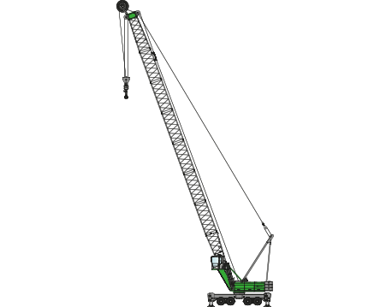
The X-Copter Project: Overview
University of
Applied Sciences
Initial state of the Project
Finished Physical model
Custom power supply circuit
Interfaces (I2C, PIOs, PWM)
Interface circuit for sensors and actors
Sensors (gyroscope, accelerometer, compass)
SoPC for the FPGA-part of DE1-SoC
Interprocessor communication with FIFOs
Drivers (partially tested)
(Some sort of USB interface)

